Slide 1

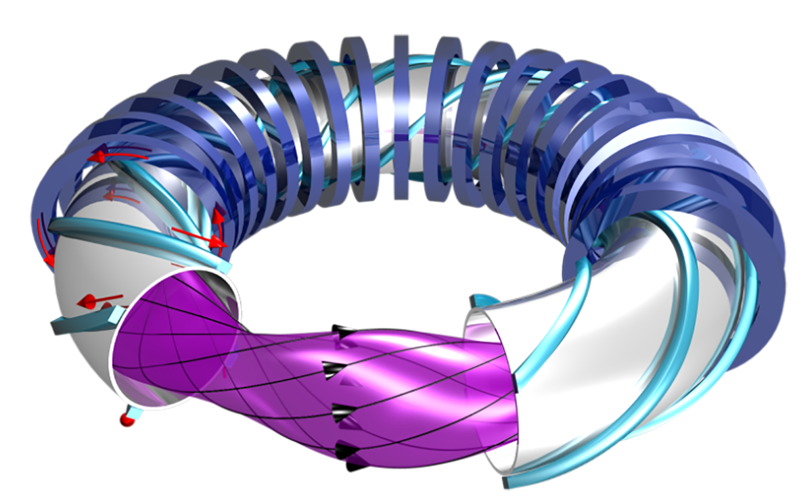
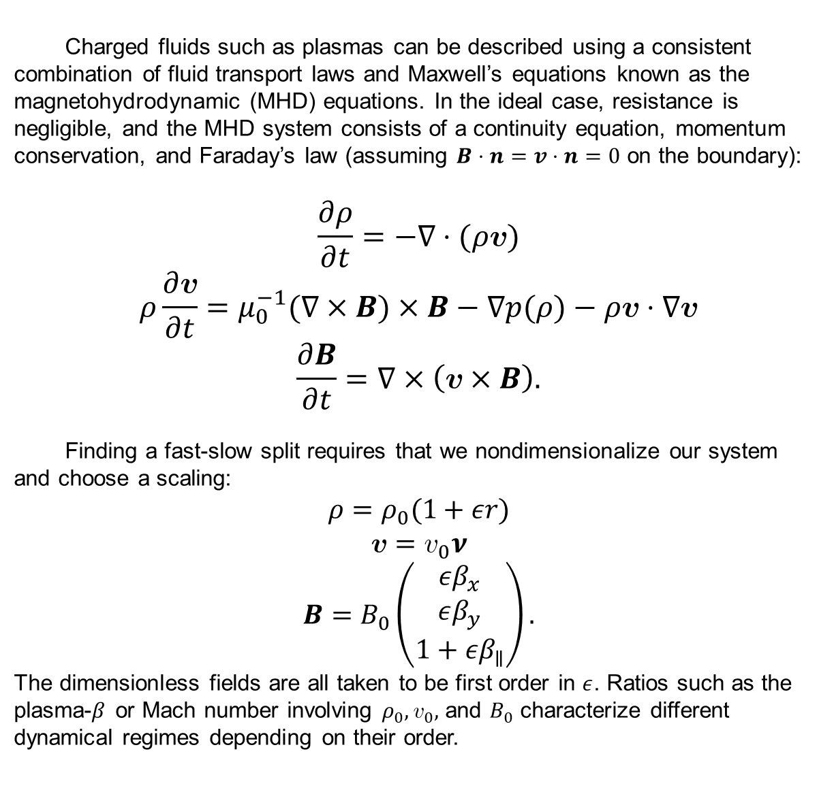
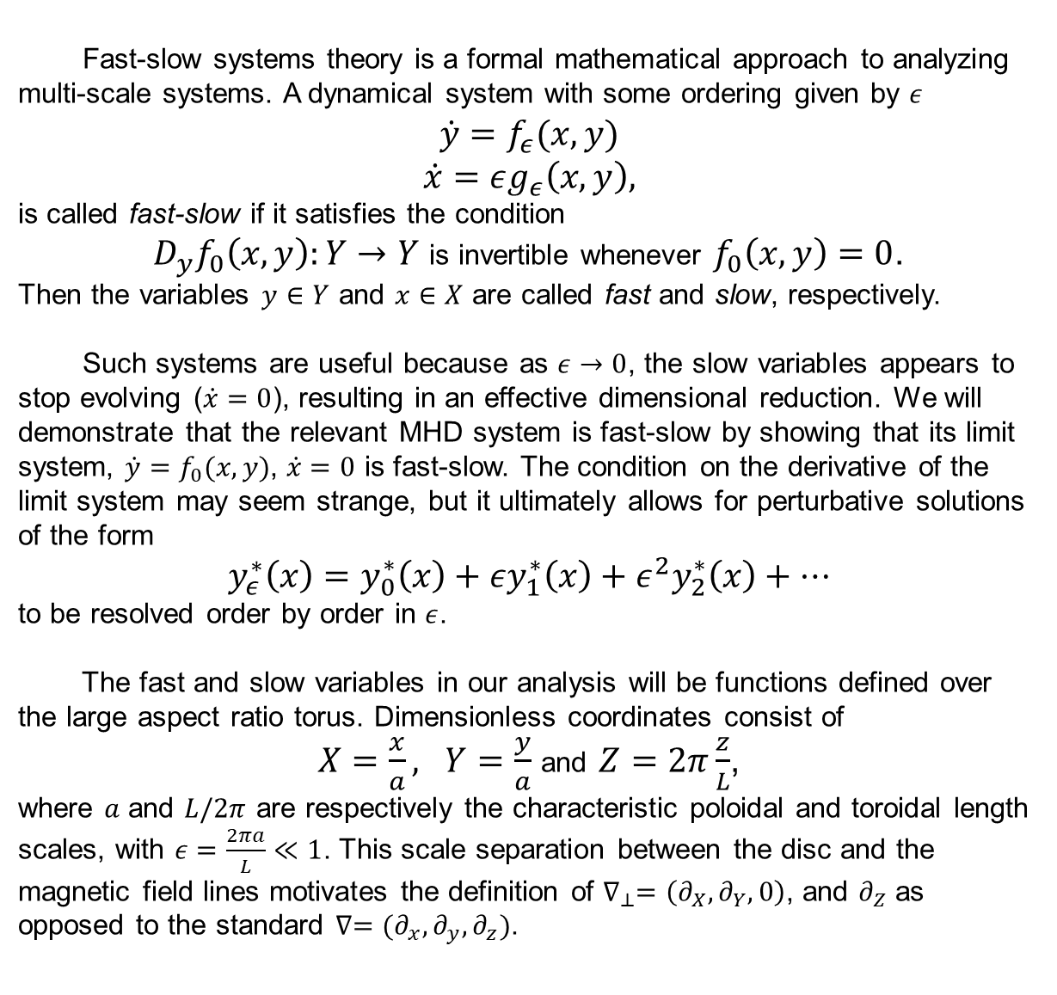
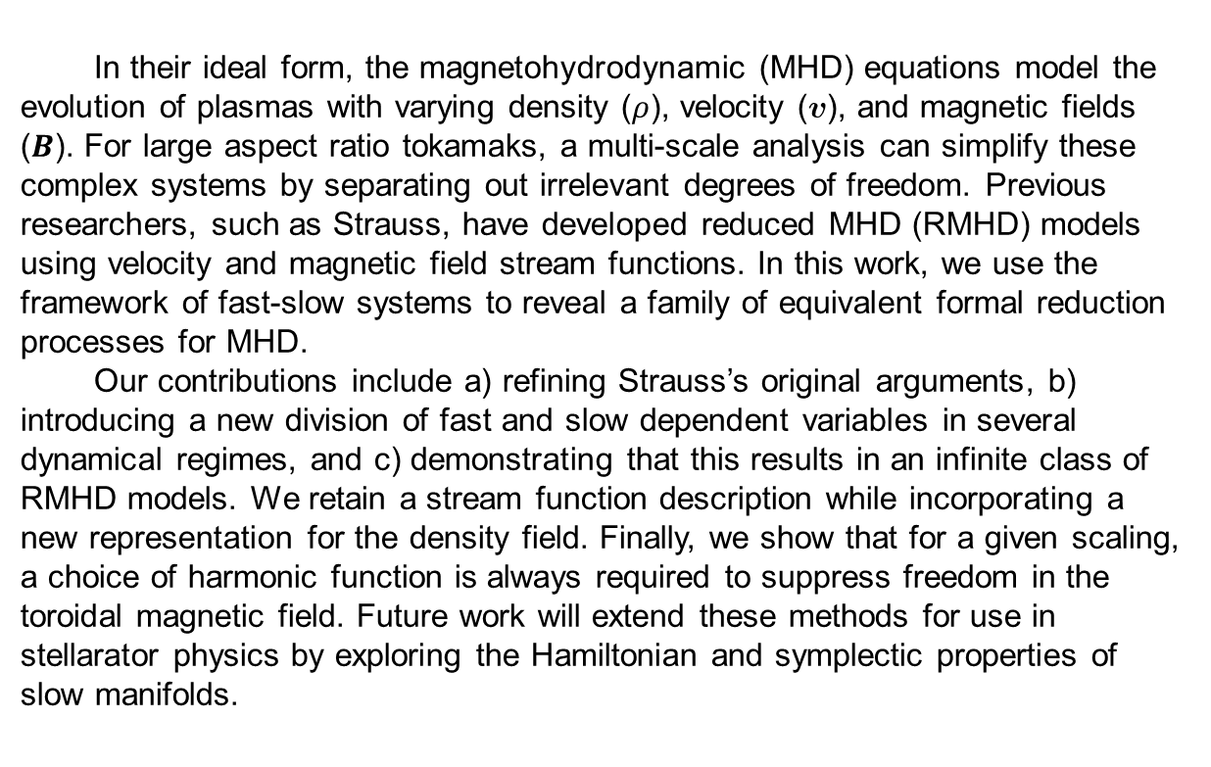
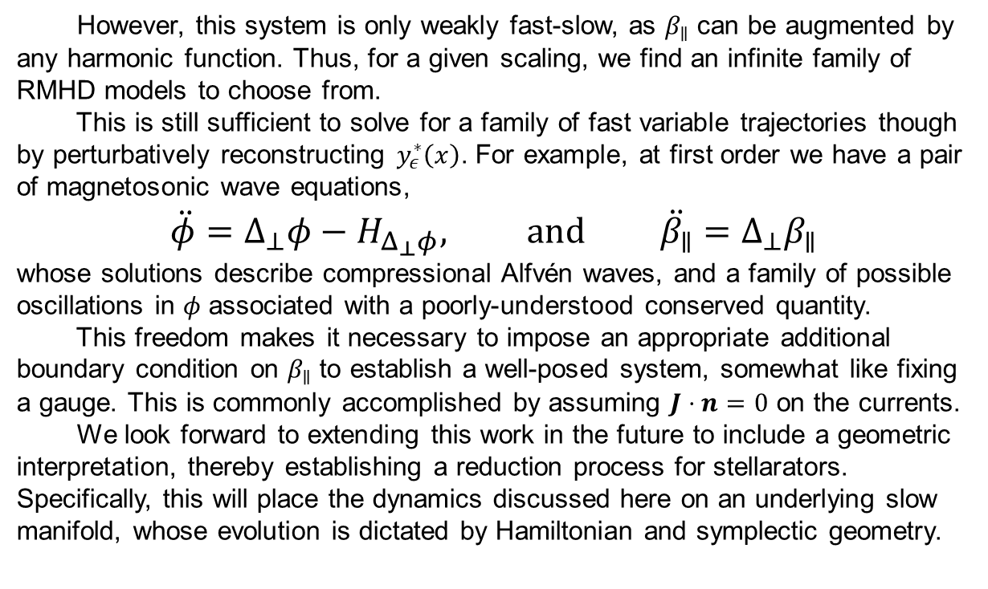
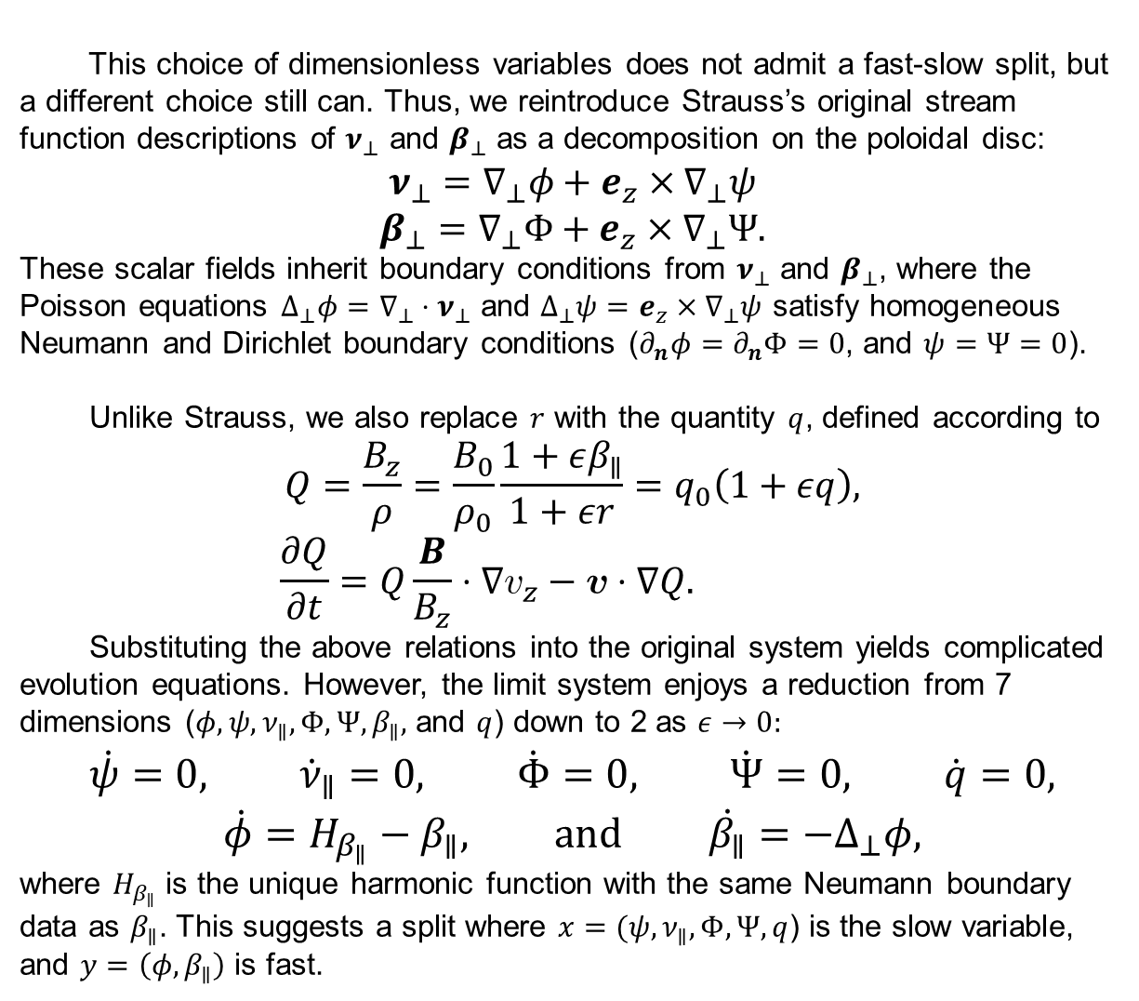
Formally Reducing the Large Aspect Ratio Magnetohydrodynamic Equations
Finny Valorz¹, Supervisor: Joshua Burby¹ ¹Department of Physics, College of Natural Sciences, The University of Texas
Introduction
MHD System and Scaling
Conclusion
In their ideal form, the magnetohydrodynamic (MHD) equations model the evolution of plasmas with varying density ($ρ$), velocity ($v$), and magnetic fields ($B$). For large aspect ratio tokamaks, a multi-scale analysis can simplify these complex systems by separating out irrelevant degrees of freedom. Previous researchers, such as Strauss, have developed reduced MHD (RMHD) models using velocity and magnetic field stream functions. In this work, we use the framework of fast-slow systems to reveal a family of equivalent formal reduction processes for MHD.
Our contributions include a) refining Strauss’s original arguments, b) introducing a new division of fast and slow dependent variables in several dynamical regimes, and c) demonstrating that this results in an infinite class of RMHD models. We retain a stream function description while incorporating a new representation for the density field. Finally, we show that for a given scaling, a choice of harmonic function is always required to suppress freedom in the toroidal magnetic field. Future work will extend these methods for use in stellarator physics by exploring the Hamiltonian and symplectic properties of slow manifolds.
Charged fluids such as plasmas can be described using a consistent combination of fluid transport laws and Maxwell’s equations known as the magnetohydrodynamic (MHD) equations. In the ideal case, resistance is negligible, and the MHD system consists of a continuity equation, momentum conservation, and Faraday’s law (assuming $B⋅n=v⋅n=0$ on the boundary):
$$\frac{∂ρ}{∂t}=−∇⋅(ρv)$$
$$ρ\frac{∂v}{∂t}=μ_{0}^{−1}(∇×B)×B−∇p(ρ)−ρv⋅∇v$$
$$\frac{∂B}{∂t}=∇×\left(v×B\right).$$
Finding a fast-slow split requires that we nondimensionalize our system and choose a scaling:
$$ρ=ρ_{0}(1+εr)$$
$$v=v_{0}ν$$
$$B=B_{0}\left(\begin{matrix}εβ_{x} \\ εβ_{y} \\ 1+εβ_{∥}\end{matrix}\right).$$
The dimensionless fields are all taken to be first order in $ε$. Ratios such as the plasma-$β$ or Mach number involving $ρ_{0},v_{0},$ and $B_{0}$ characterize different dynamical regimes depending on their order.
Research Goal
https://www.iaea.org/bulletin/magnetic-fusion-confinement-with-tokamaks-and-stellarators
In this project, we carry out a dimensional reduction of the MHD equations by finding a fast-slow split. This method reveals a freedom to reduce MHD in infinitely many equivalent ways.
However, this system is only weakly fast-slow, as $β_{∥}$ can be augmented by any harmonic function. Thus, for a given scaling, we find an infinite family of RMHD models to choose from.
This is still sufficient to solve for a family of fast variable trajectories though by perturbatively reconstructing $y_{ε}^{∗}\left(x\right)$. For example, at first order we have a pair of magnetosonic wave equations,
$$\ddot{φ}=Δ_{⊥}φ−H_{Δ_{⊥}φ}, and \ddot{β_{∥}}=Δ_{⊥}β_{∥}$$
whose solutions describe compressional Alfvén waves, and a family of possible oscillations in $φ$ associated with a poorly-understood conserved quantity.
This freedom makes it necessary to impose an appropriate additional boundary condition on $β_{∥}$ to establish a well-posed system, somewhat like fixing a gauge. This is commonly accomplished by assuming $J⋅n=0$ on the currents.
We look forward to extending this work in the future to include a geometric interpretation, thereby establishing a reduction process for stellarators. Specifically, this will place the dynamics discussed here on an underlying slow manifold, whose evolution is dictated by Hamiltonian and symplectic geometry.
Slow Manifold Reduction
Finding Fast-Slow Split
Fast-slow systems theory is a formal mathematical approach to analyzing multi-scale systems. A dynamical system with some ordering given by $ε$
$$\dot{y}=f_{ε}(x,y)$$
$$\dot{x}=εg_{ε}\left(x,y\right),$$
is called fast-slow if it satisfies the condition
$D_{y}f_{0}\left(x,y\right):Y→Y$ is invertible whenever $f_{0}\left(x,y\right)=0$.
Then the variables $y∈Y$ and $x∈X$ are called fast and slow, respectively.
Such systems are useful because as $ε→0$, the slow variables appears to stop evolving ($\dot{x}=0$), resulting in an effective dimensional reduction. We will demonstrate that the relevant MHD system is fast-slow by showing that its limit system, ${\dot{y}=f}_{0}(x,y)$, $\dot{x}=0$ is fast-slow. The condition on the derivative of the limit system may seem strange, but it ultimately allows for perturbative solutions of the form
$$y_{ε}^{∗}\left(x\right)=y_{0}^{∗}\left(x\right)+εy_{1}^{∗}\left(x\right)+ε^{2}y_{2}^{∗}\left(x\right)+⋯$$
to be resolved order by order in $ε$.
The fast and slow variables in our analysis will be functions defined over the large aspect ratio torus. Dimensionless coordinates consist of
$X=\frac{x}{a}, Y=\frac{y}{a}$ and $Z=2π\frac{z}{L}$,
where $a$ and $L/2π$ are respectively the characteristic poloidal and toroidal length scales, with $ε=\frac{2πa}{L}≪1$. This scale separation between the disc and the magnetic field lines motivates the definition of $∇_{⊥}=\left(∂_{X},∂_{Y},0\right)$, and $∂_{Z}$ as opposed to the standard $∇=(∂_{x},∂_{y},∂_{z})$.
This choice of dimensionless variables does not admit a fast-slow split, but a different choice still can. Thus, we reintroduce Strauss’s original stream function descriptions of $ν_{⊥}$ and $β_{⊥}$ as a decomposition on the poloidal disc:
$$ν_{⊥}=∇_{⊥}φ+e_{z}×∇_{⊥}ψ$$
$$β_{⊥}=∇_{⊥}Φ+e_{z}×∇_{⊥}Ψ.$$
These scalar fields inherit boundary conditions from $ν_{⊥}$ and $β_{⊥}$, where the Poisson equations $Δ_{⊥}φ=∇_{⊥}⋅ν_{⊥}$ and $Δ_{⊥}ψ=e_{z}×∇_{⊥}ψ$ satisfy homogeneous Neumann and Dirichlet boundary conditions ($∂_{n}φ=∂_{n}Φ=0$, and $ψ=Ψ=0$).
Unlike Strauss, we also replace $r$ with the quantity $q$, defined according to
$$Q=\frac{B_{z}}{ρ}=\frac{B_{0}}{ρ_{0}}\frac{1+εβ_{∥}}{1+εr}=q_{0}\left(1+εq\right),$$
$$\frac{∂Q}{∂t}=Q\frac{B}{B_{z}}⋅∇v_{z}−v⋅∇Q.$$
Substituting the above relations into the original system yields complicated evolution equations. However, the limit system enjoys a reduction from 7 dimensions ($φ, ψ, ν_{∥}, Φ, Ψ, β_{∥},$ and $q$) down to 2 as $ε→0$:
$$\dot{ψ}=0, {\dot{ν}}_{∥}=0, \dot{Φ}=0, \dot{Ψ}=0, \dot{q}=0,$$
$$\dot{φ}=H_{β_{∥}}−β_{∥}\text{,} \text{and} \dot{β_{∥}}=−Δ_{⊥}φ,$$
where $H_{β_{∥}}$ is the unique harmonic function with the same Neumann boundary data as $β_{∥}$. This suggests a split where $x=(ψ,ν_{∥},Φ,Ψ,q$) is the slow variable, and $y=\left(φ,β_{∥}\right)$ is fast.
Acknowledgements
I would like to thank Joshua Burby for his guidance and support throughout this project. Thank you also to the other researchers and students in my group, especially Finn Pinto, for our insightful conversations.
References
H. R. Strauss. ‘Dynamics of high β tokamaks’, Phys. Fluids 20, 1354 (1977).
H. R. Strauss. ‘Nonlinear, three-dimensional magnetohydrodynamics of
noncircular tokamaks’, Phys. Fluids 19, 134 (1976).
J. W. Burby and T. J. Klotz. ‘Slow manifold reduction for plasma science,’
CNSNS 89, (2020).

